Slide 1

ACTION RECOGNITION IN VIDEO
Undergraduate Reseach Opportunities Programme 2023-24
Team Members:
Joydeep Ghosh | AP21110010557
Dedipya Goswami | AP21110010650
DM Akshay | AP21110011219

Slide 2

Table of Contents
Introduction
Objectives
What?
How?
3D CNN
CNN RNN
Results and Output
Conclusion
Future Scope
Dataset

Slide 3

INTRODUCTION
Our Project is based on understanding of the how Video Classifiers work in identifying the actions performed when a video is passed on to it. In this Research opportunity we have performed a thorough study of Video classifiers based on two architectures namely – 3D CNN and CNN-RNN architectures and have analyzed their effectiveness in recognizing and categorizing actions depicted within video sequences.
Through this research, we aim to unveil the strengths, limitations, and comparative performance of these architectures in accurately identifying and interpreting diverse actions within video data
D M AKSHAY - AP21110011219

Slide 4
OBJECTIVES OF OUR PROJECT
Understanding Human Behavior.
Optimization and Improvement.
Applicability in Diverse Scenarios.
In summary, conducting a thorough comparison of different architectures for video classification is crucial for both theoretical understanding and practical applications, fostering advancements in technology and aiding in informed decision-making across various industries
D M AKSHAY - AP21110011219

Slide 5

Dataset
UCF101 stands as an expansive repository of genuine action videos, meticulously curated from YouTube and featuring an extensive spectrum of 101 distinct action categories. Serving as an evolutionary extension of the UCF50 dataset, which concentrated on 50 action categories,UCF101 substantially broadens the scope of action recognition research. The subset of the dataset taken by us consists of 5 classes namely, “CricketShot”, “PlayingCello”, "Punch”, “ShavingBeard”, “TennisSwing”. There are a total of 600 videos allocated for training both models namely 3D-CNN and hybrid CNN RNN(GRU). Each Video class consists of around 120 videos of the respective action.
D M AKSHAY - AP21110011219

Slide 6
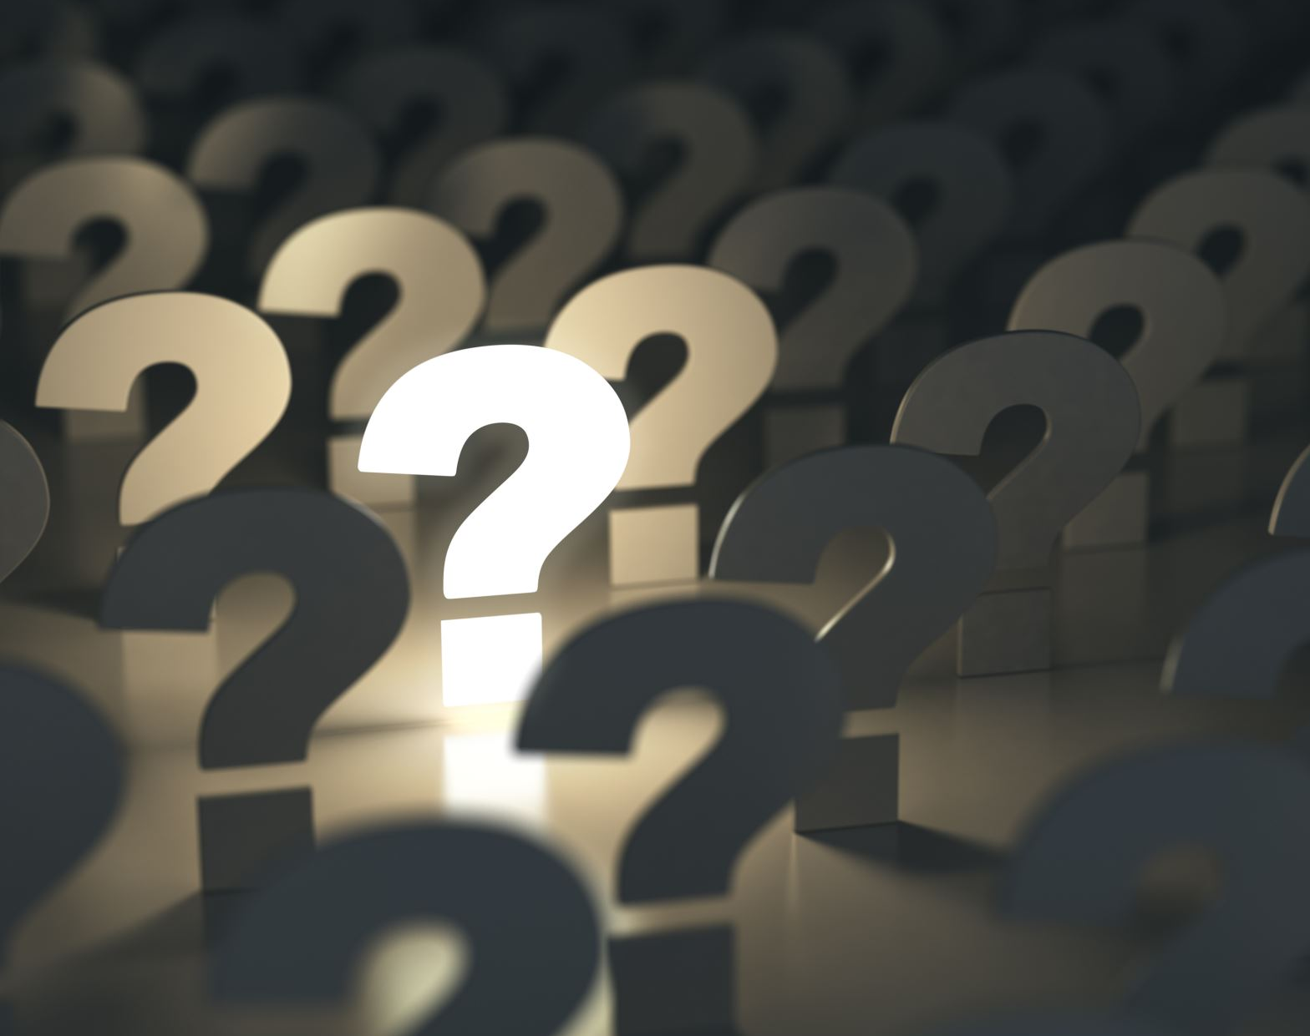
What?

Slide 7
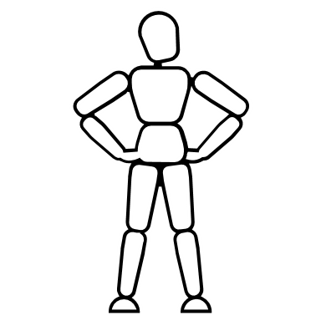
ACTION RECOGNITION
3D Convolutional Neural Networks
A 3D Convolutional Neural Network (3D CNN) as refers to neural network architectures with multiple layers that can learn hierarchical data representations. Each layer learns increasingly complex spatial features of data. A 3D CNN specifically designed to analyse spatiotemporal patterns in volumetric data, such as video sequences or medical imaging scans.
3D CNNs extend the convolution operation into the temporal dimension, allowing them to capture both spatial and temporal dependencies within a dataset. In a 3D CNN architecture, the first few layers typically focus on extracting basic spatial and temporal features, while deeper layers learn more complex and abstract representations. This hierarchical learning enables the network to discern intricate patterns and relationships within volumetric data.
Joydeep Ghosh - AP21110010557

Slide 8
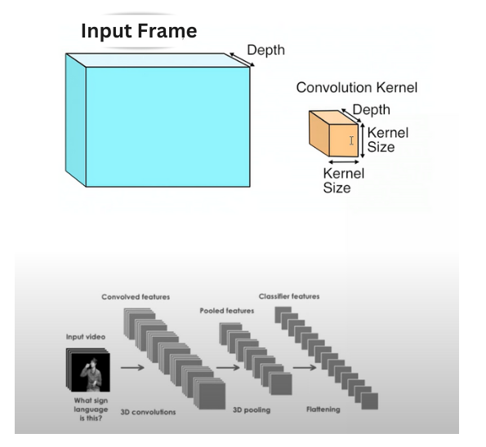
How 3D CNN Architecture Works??
Joydeep Ghosh - AP21110010557

Slide 9
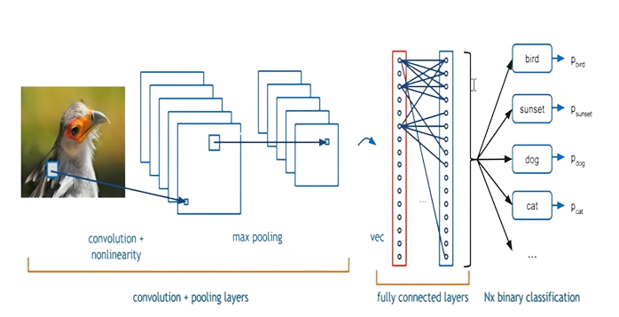
Example of Working of 3D CNN
Joydeep Ghosh - AP21110010557

Slide 10
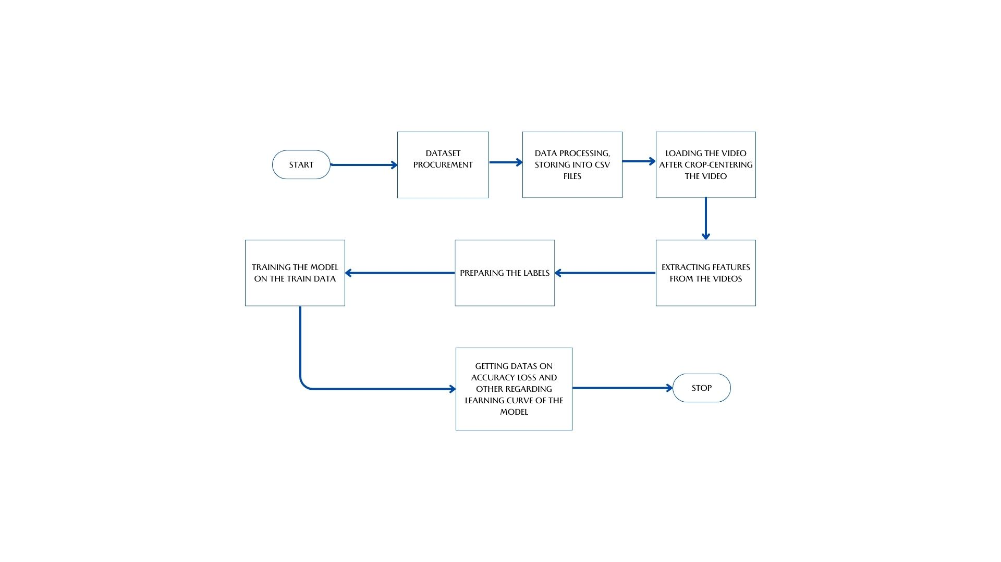
Video Classification using 3D CNN
Joydeep Ghosh - AP21110010557

Slide 11
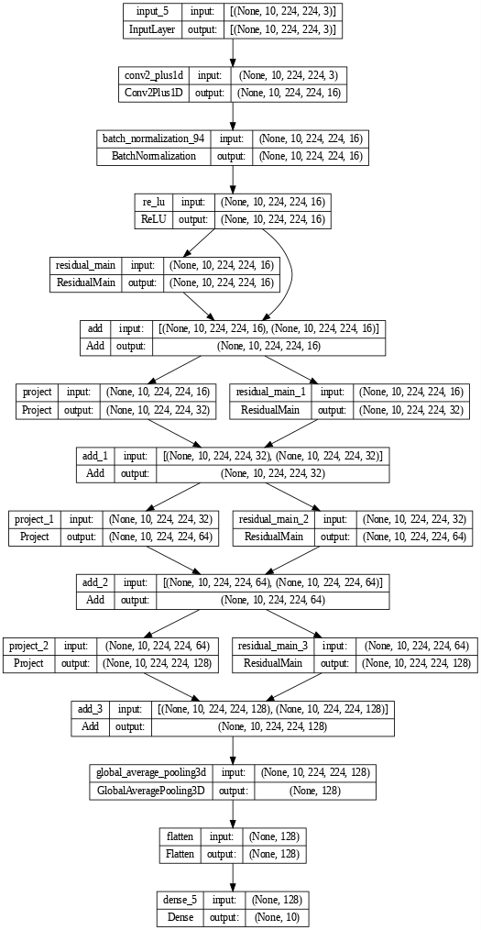
3D CNN ARCHITECTURE DIAGRAM
Joydeep Ghosh - AP21110010557

Slide 12

ACTION RECOGNITION
Convolutional Neural Networks(CNN)- Recurrent Neural Network(RNN)
A CNN-RNN hybrid, combines the strengths of both CNNs and RNNs to effectively process complex sequential data. In this architecture, the CNN is employed for spatial feature extraction, capturing hierarchical patterns and spatial relationships within the input data, while the RNN, specifically using Gated Recurrent Unit (GRU) layers, is incorporated to handle the temporal dynamics and sequential dependencies.
The CNN-RNN hybrid is particularly well-suited for tasks where understanding both spatial structures and temporal sequences is crucial, such as video analysis, image captioning, and speech recognition. The CNN extracts spatial features from the input, and the RNN, with its memory and recurrent connections, processes the temporal sequence, allowing the model to capture long-range dependencies in the data.
Dedipya Goswami - AP21110010650

Slide 13
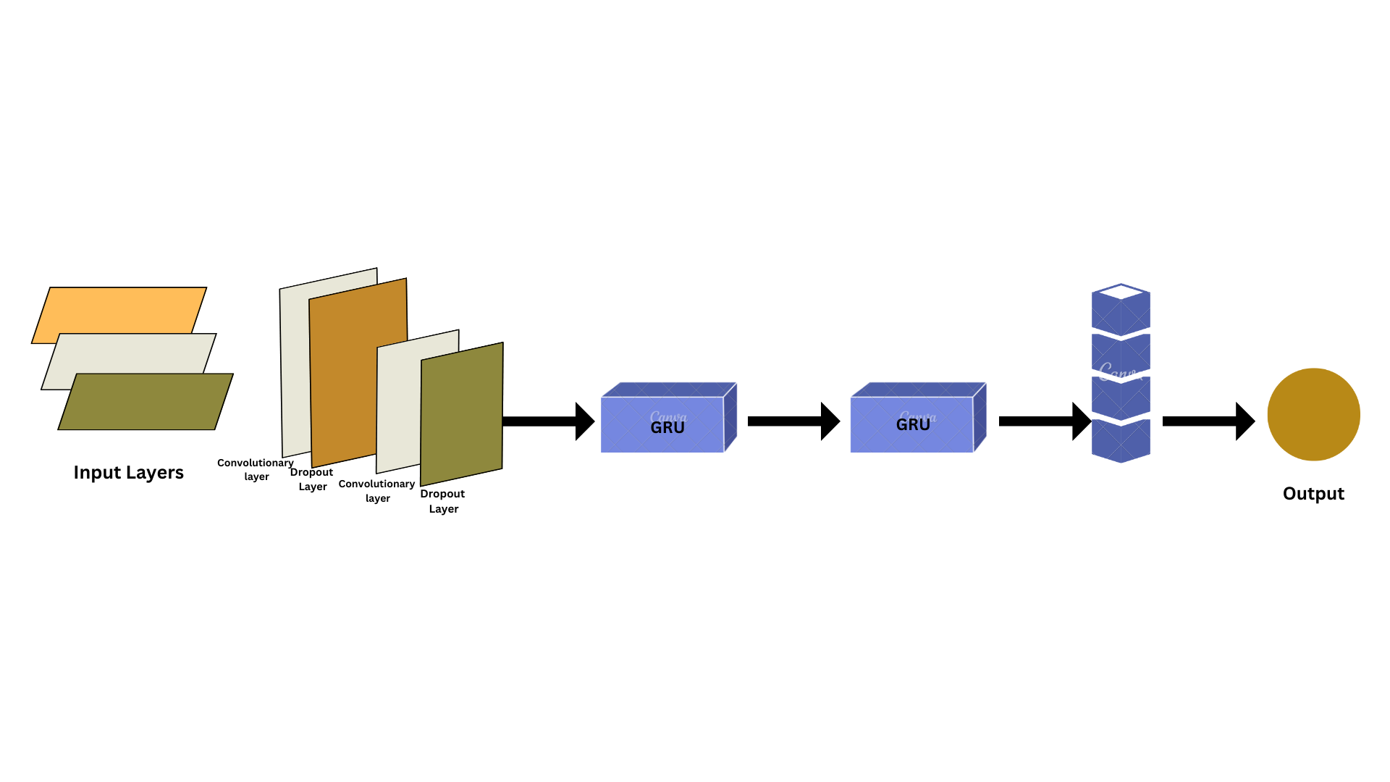
How does CNN-RNN (GRU layers) Work ?
Dedipya Goswami - AP21110010650

Slide 14
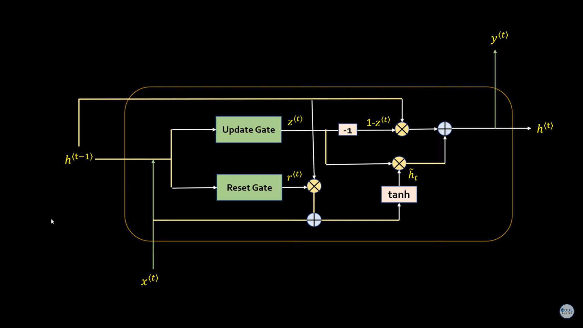
Structure of GRU
Dedipya Goswami - AP21110010650

Slide 15
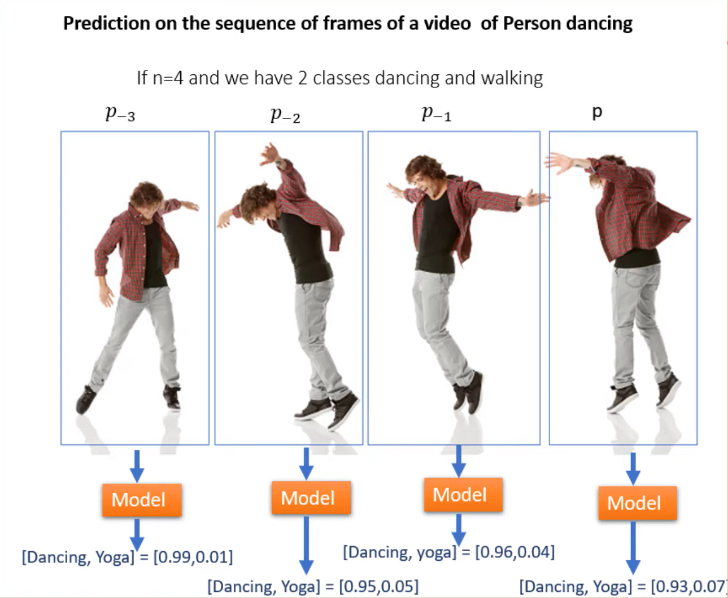
Example of Working of CNN-RNN architecture
Dedipya Goswami - AP21110010650

Slide 16
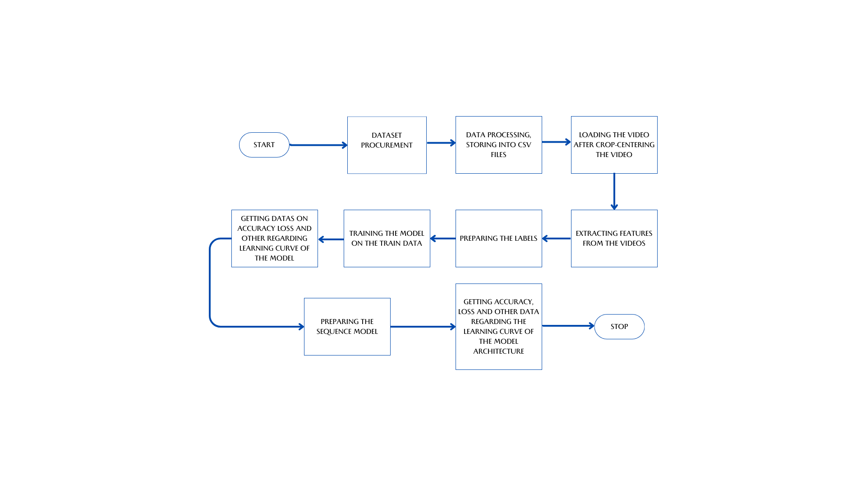
Video Classification using CNN-RNN
Dedipya Goswami - AP21110010650

Slide 17
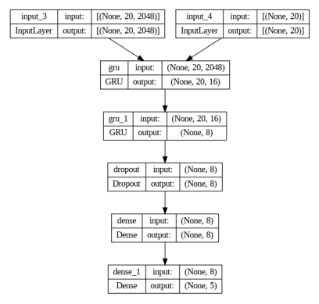
CNN-RNN Architecture
Dedipya Goswami - AP21110010650

Slide 18

Results and Outputs
D M AKSHAY - AP21110011219

Slide 19
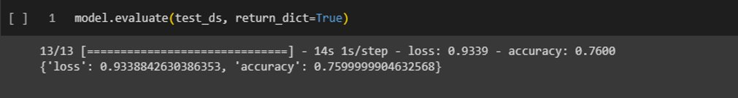
Accuracy for CNN architecture
Therefore, the accuracy for the CNN architecture, Video Classification Model is :​ ​ 100 * 0.7599 = 75.99 ~ 76 %
D M AKSHAY - AP21110011219

Slide 20
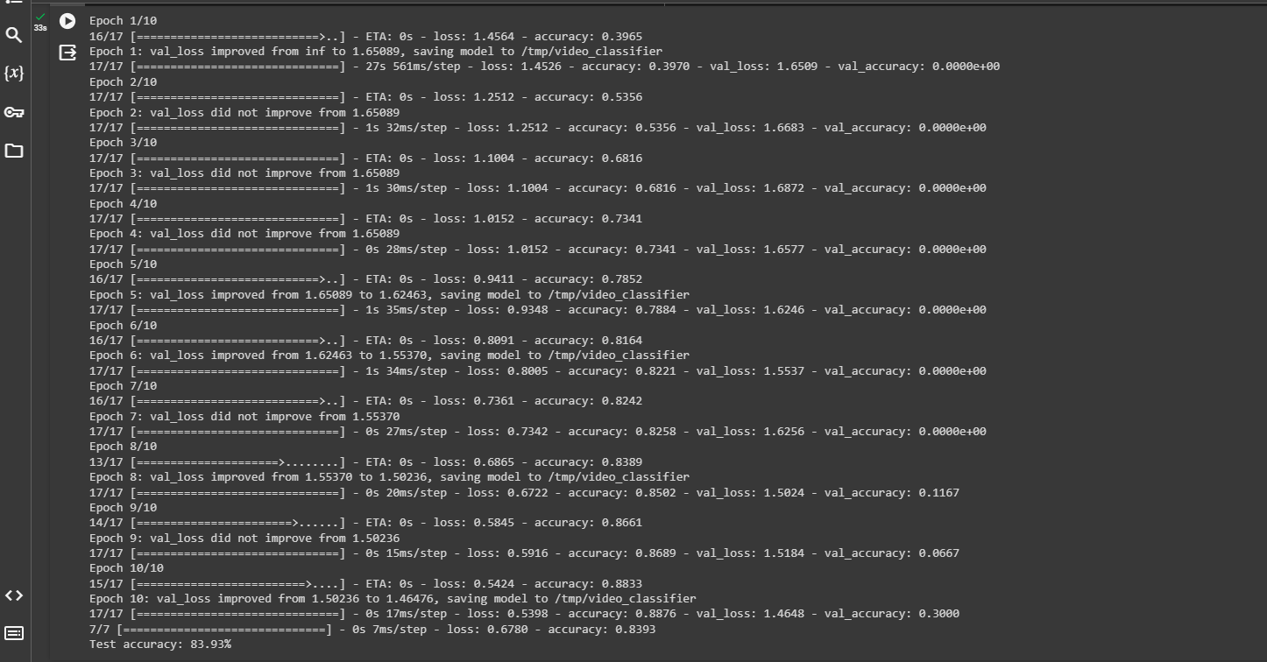
Accuracy for CNN-RNN architecture
D M AKSHAY - AP21110011219

Slide 21
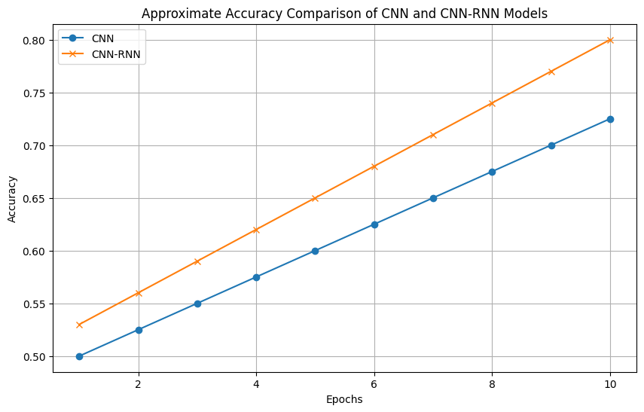
Comparing the Two Models (Accuracy)
Accuracy Curves Comparison :
D M AKSHAY - AP21110011219

Slide 22
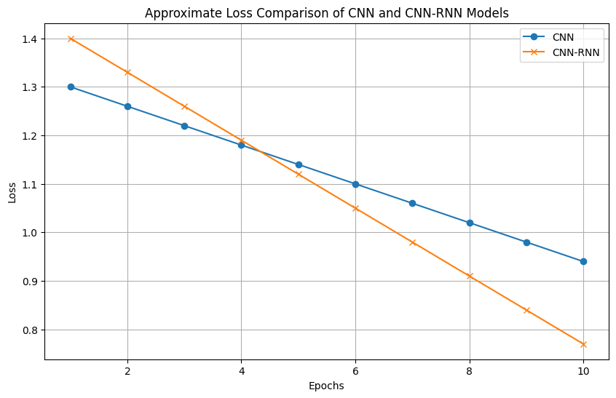
Comparing the Two Models (Loss)
Loss Curves Comparison :
D M AKSHAY - AP21110011219

Slide 23
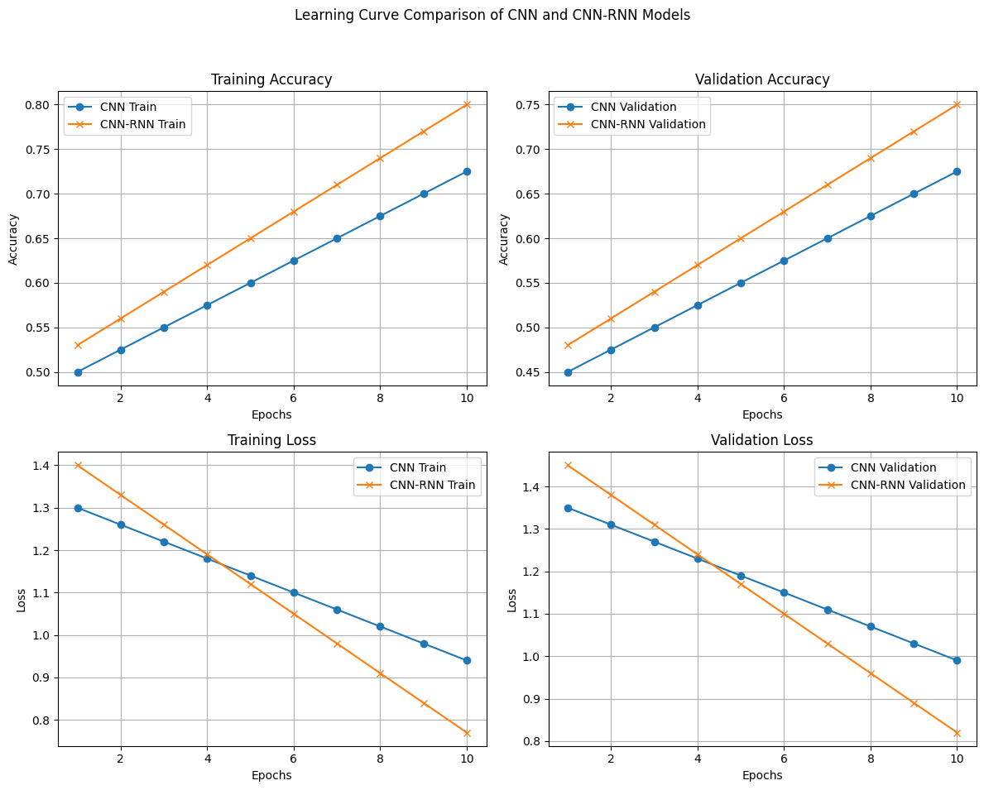
Comparing the Two Models (Learning)
Learning Curves Comparison :
D M AKSHAY - AP21110011219

Slide 24
CONCLUSION
According to the Results that we have got from our Models trained on a particular dataset, we can conclude that :
On lower epochs, i.e. Epochs in the range of 1-5 , the accuracy of CNN is more than of CNN-RNN but,
At 6 they the curves coincide to a point where they are both same
After 6 the accuracy of CNN-RNN starts increasing and surpasses the CNN curve.
Loss of CNN-RNN is more up to 10 epochs but it reduces, and the two curves start to coincide as we increase the number of epochs.
D M AKSHAY - AP21110011219

Slide 25

FUTURE SCOPE
3 OBJECTIVES
D M AKSHAY - AP21110011219

Slide 26
